Slide 1
Data Visualization of Titanic Dataset
- Using Matplotlib and Seaborn Library

Slide 2
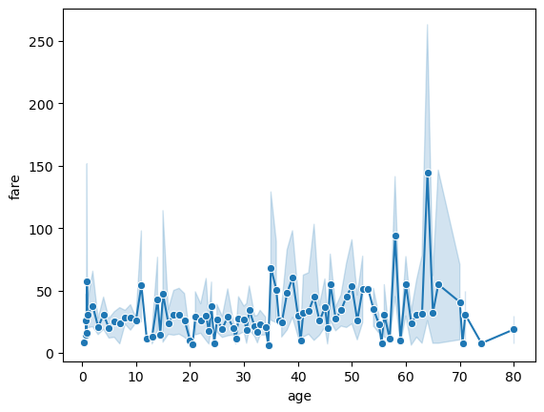
Passengers who have the age between 62 to 76 pay maximum fair.

Slide 3
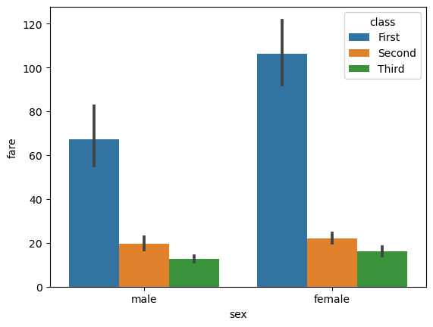
1st Class Females Pay Maximum Fair

Slide 4
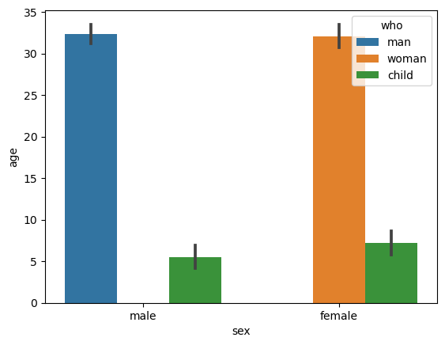
Average age of Adult Male and Female is approx. 33 and Age of Male Child is 5 and Female Child is 6.

Slide 5
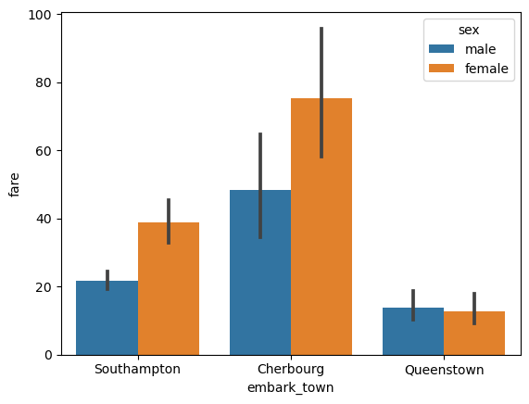
Cherbourg Town Passengers gave maximum Fare and Queenstown’s Passengers gave Less Fare.

Slide 6
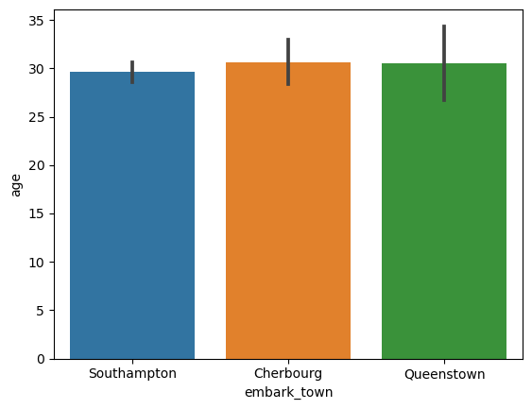
Average Age of Passengers of Southampton Town is Minimum

Slide 7
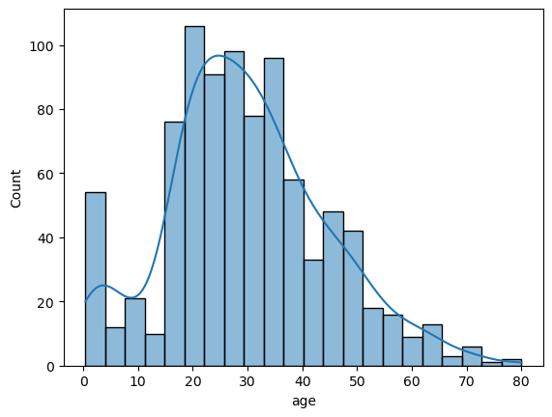
Age of Most Passengers in between 25 to 30.

Slide 8
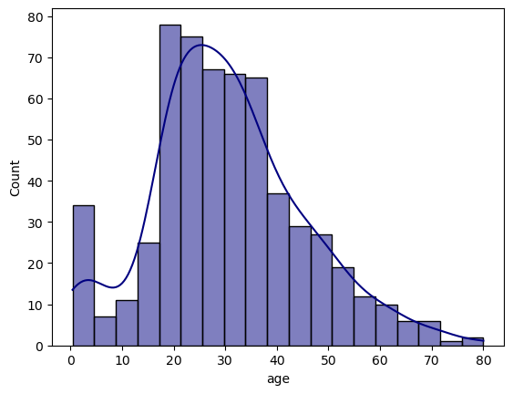
Age of Most Male Passengers in between 20 to 30.

Slide 9
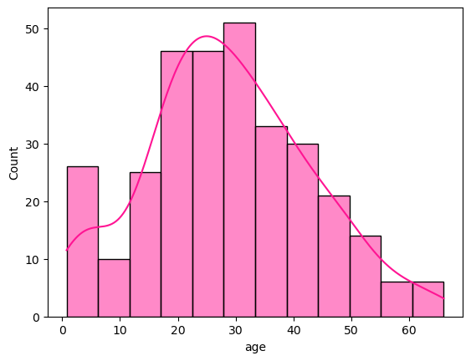
Age of Most Female Passengers in between 25 to 30.

Slide 10
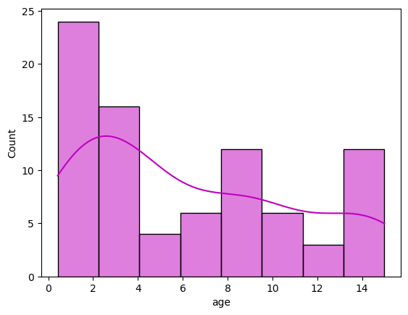
Age of Most Child Passengers in between 1 to 4.

Slide 11
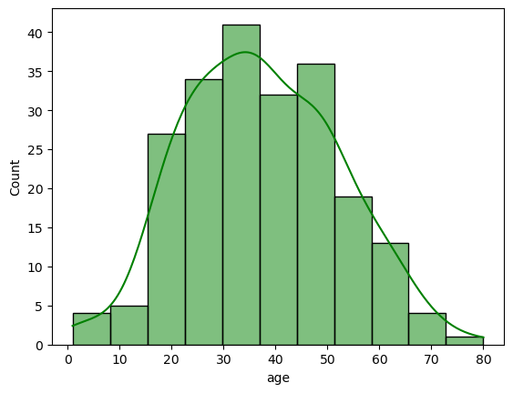
Age of Most 1st Class Passengers in between 30 to 35.

Slide 12
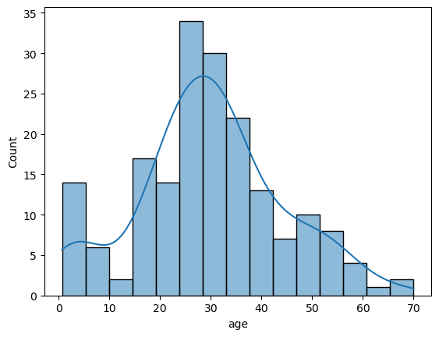
Age of Most 2nd Class Passengers in between 25 to 35.

Slide 13
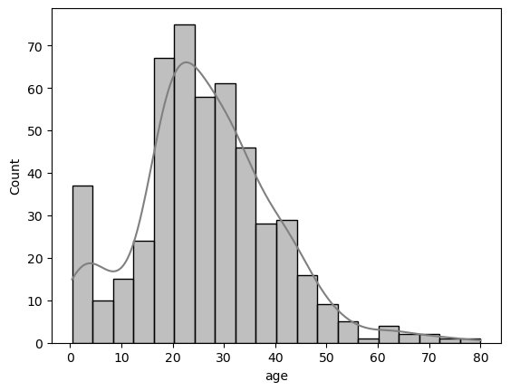
Age of Most 3rd Class Passengers in between 20 to 25.

Slide 14
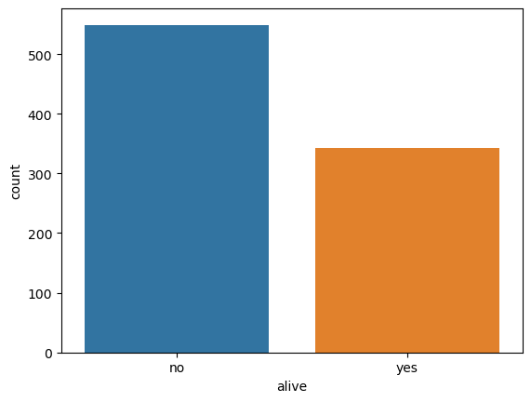
Count of Alive Passengers is Less than Non Alive Passengers.

Slide 15
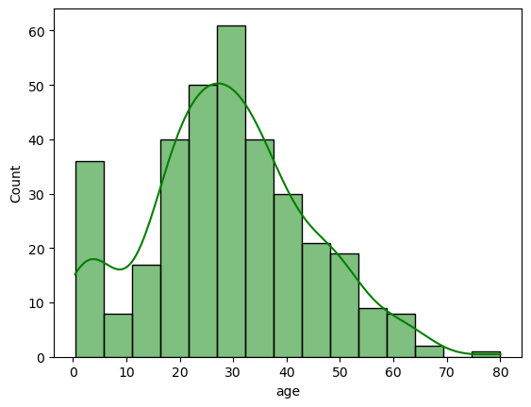
Maximum Alive Passengers in Age between 20 to 30.

Slide 16
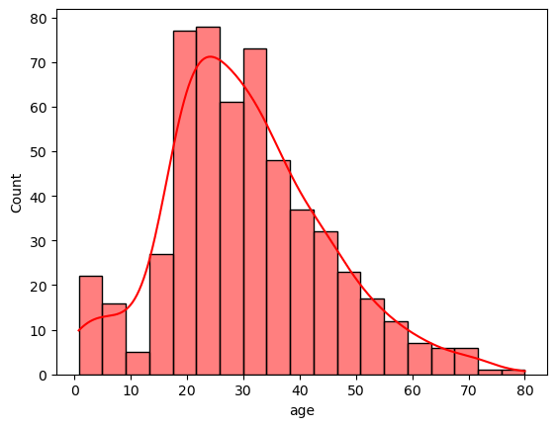
Maximum Not Alive Passengers in Age between 20 to 30.

Slide 17
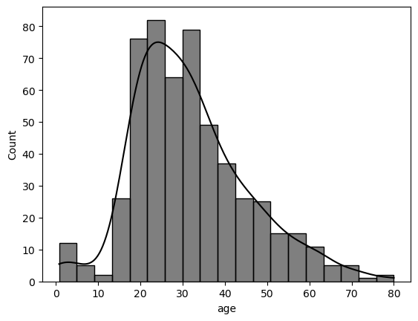
Maximum Alone Passengers Age in between 25 to 25.

Slide 18
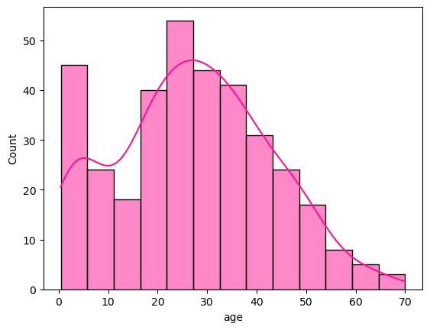
Maximum Alone Passengers Age in between 20 to 35.

Slide 19
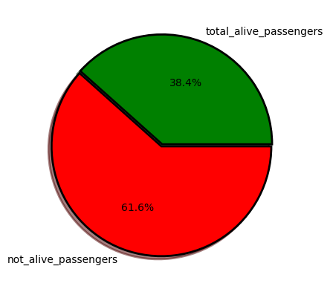
Most of the Passengers are not Alive.

Slide 20
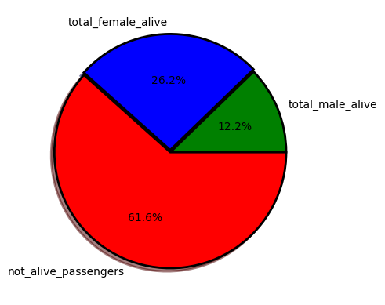
Female Passengers Alive more than Male.

Slide 21
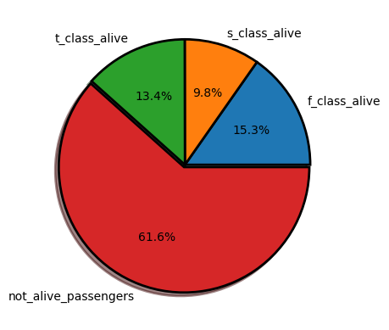
2nd Class Passengers are Less Alive.

Slide 22
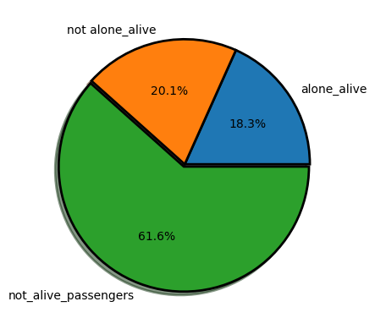
Alone Passengers are Alive Less than Not Alone Passengers.

Slide 23
Thank You

